Slide 1
Data Athletics
Analyzing triathlete's performance - Abhi

Slide 2
Agenda
Project background
Hypothesis
Data analysis and Visualization
Code
Future
Questions

Slide 3
Hypothesis
Can we predict athlete’s future performances based on race history and training data ?
Looking back can we quantify what went well and what did not during a race ?
All (most) serious athletes are data geeks and wealthy

Slide 4
(Half)IronMan Triathlon
Born on the Hawaiian island of Oahu in 1978
Ironman: 2.4-mile swim, 112-mile bike and 26.2-mile
Half Ironman: 1.2 mile swim, 56 mile bike, 13.1 mile run
Over the years, 88 different countries have been represented at the championship
More than 60,000 triathletes try each year, but only about 2000+ win coveted Kona Slots (1700+ qualifiers, plus lottery winners, etc.)
More than +$150 million in revenue

Slide 5
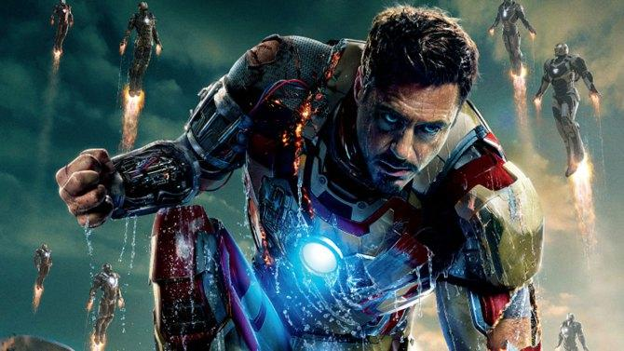

Slide 6
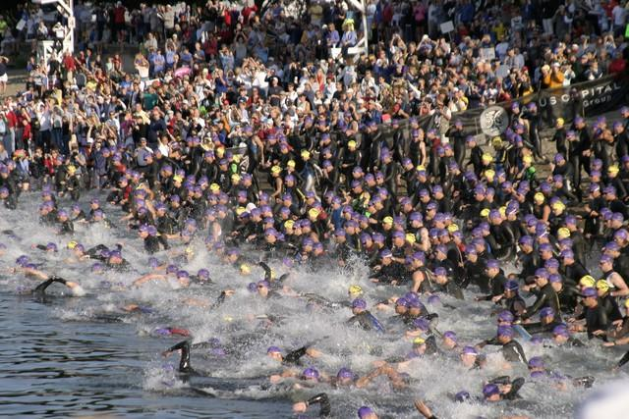

Slide 7
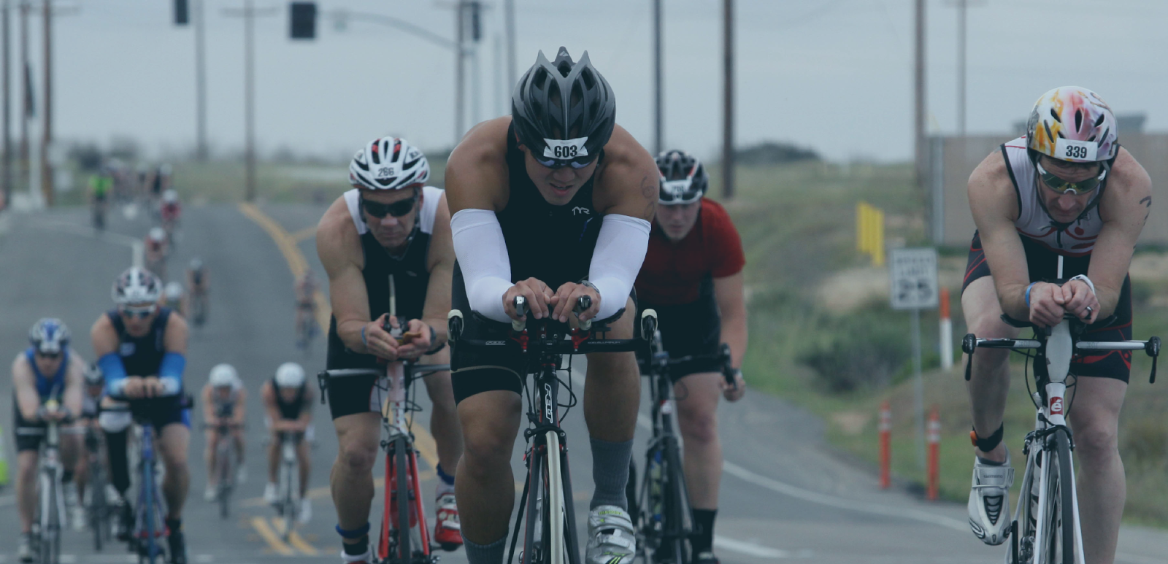

Slide 8
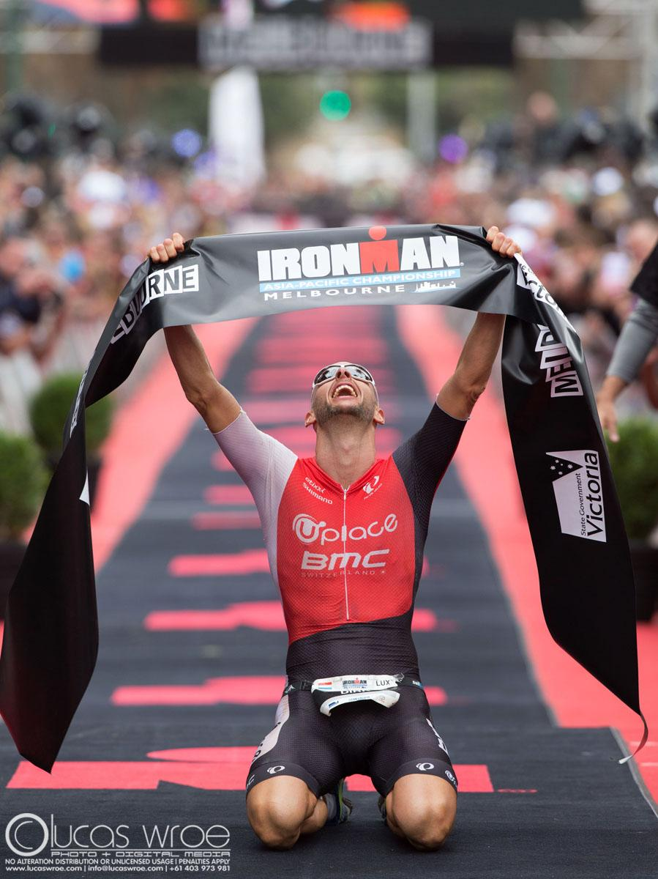

Slide 9
Data Gathering
Nodejs + Cheerio for scraping
Weather data
Amazon RDS
~400K rows for Half Ironman
~450K rows for Ironman
~12 Race factors (Attributes)
Challenges:
No clean API
Unreliable website (Athlinks)
Missing data

Slide 10
Dataset
Race result data comprised of Bike, Run, Swim and Final time
Race factor data comprised of Starting/Max and Gross elevation, Temperature, Humidity, Peak wind speed, Sunrise and Sunset etc

Slide 11
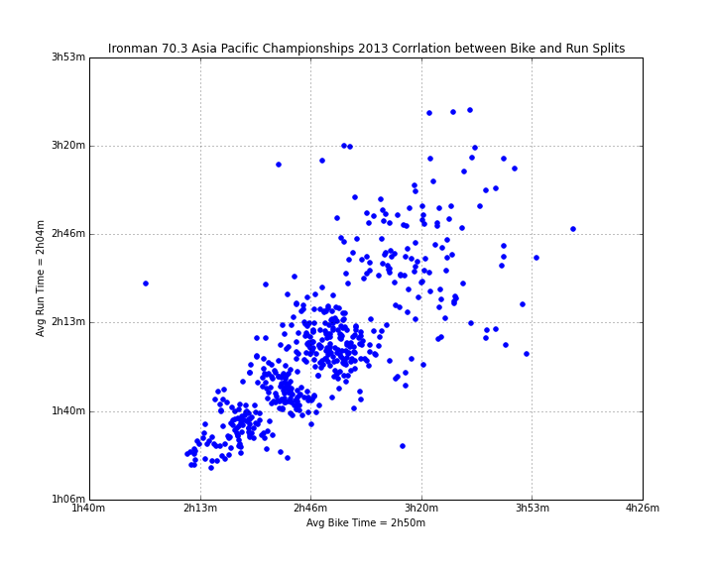
Data Exploration

Slide 12
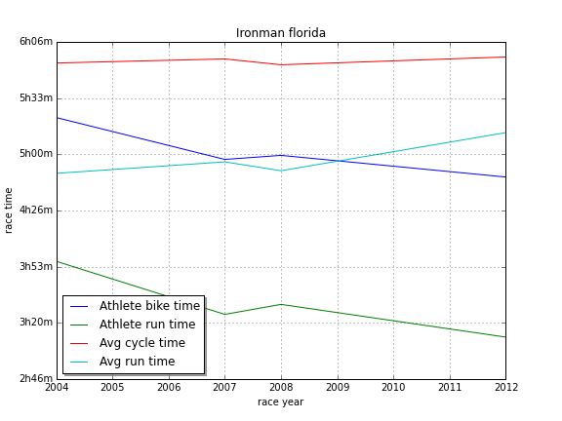
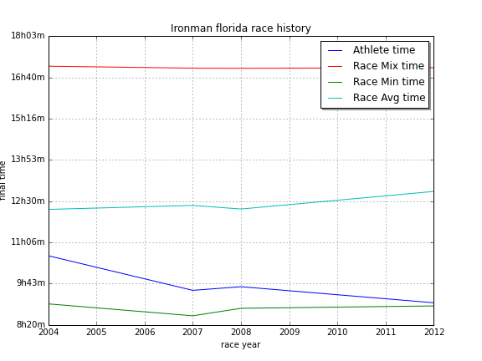

Slide 13
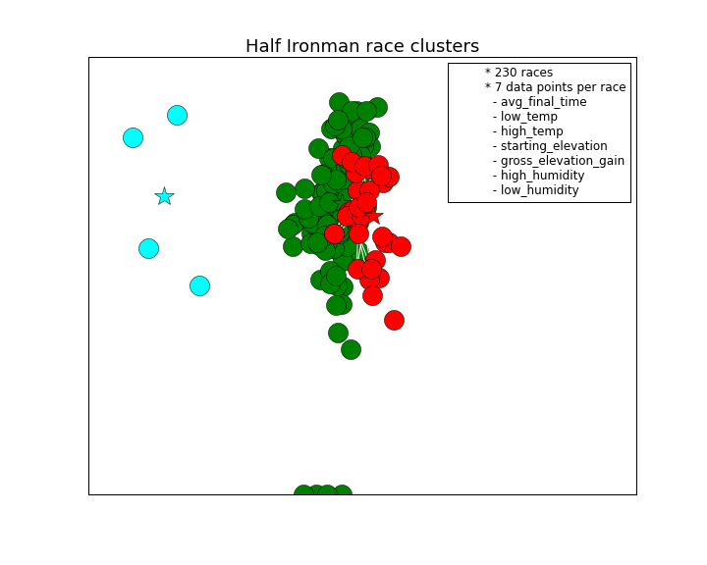

Slide 14
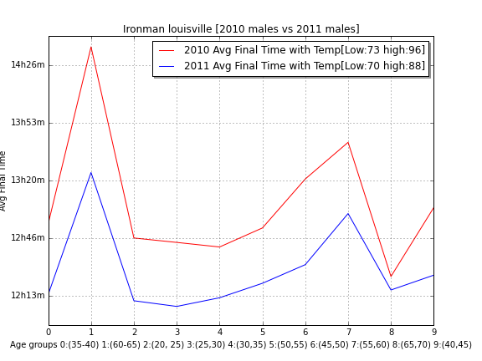

Slide 15
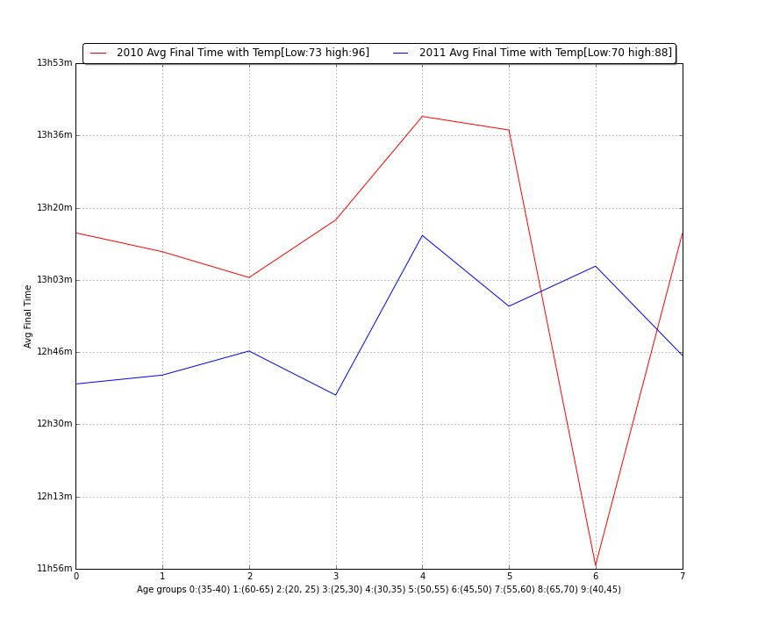

Slide 16
Neural Network
Feed Forward Network
Pros:
Predict race distribution for a given set of race factors
Confirmed hypotheses about race factors affecting population in a consistent way
Cons:
Wasn’t useful for personalized results

Slide 17
Code setup
6 Input (Race factors) and 15 output (race bins with population percent) layers with 5 hidden layers (with Sigmoid activation function)
90/10 split into Train/Test dataset
1000 epochs took ~45mins
Standard sum-of-squares error
Used Pybrain python library
Code on Github => Feed forward network

Slide 18
Pivot

Slide 19
Power Analysis
Cyclists: The power a rider would need to produce to achieve a certain speed or event time or conversely the speed or time that could be expected for a given power output.
Can we do similar for running ?

Slide 20
Physiological Models
Modeling the energetics of 100-m running by using speed curves of world champions - Laurent M Arsac and Elio Locatelli
Mathematical analysis of running performance and world running records
Francois Pfironnet and Guy Thibault
The energetics of endurance running
di Prampero PE, Atchou G, Brückner JC, Moia C.

Slide 21
Power analysis
Power (W/kg)=(C * n*V - (C * n*V * (.5 * (V * 8.33-1)))) + C_aero + C_kin
Datathletics Power Calculator - Power is the rate of doing work
Careo = Energy required to overcome air resistance where: C_aero = k * d^3 * n ^-1 * t^-3) k = 0.5*p*Af*Cd p = sea level air density Af = frontal_area Cd = drag coefficient = 0.9 n = 0.5 V = avg running velocity = distance/time
Ckin = Energy required to change kinetic energy C_kin = 0.5 * n^-1 * d^2 * t^-3

Slide 22
Next Steps ?
Power curve
Test with athletes
Get Feedback
Continue data exploration

Slide 23
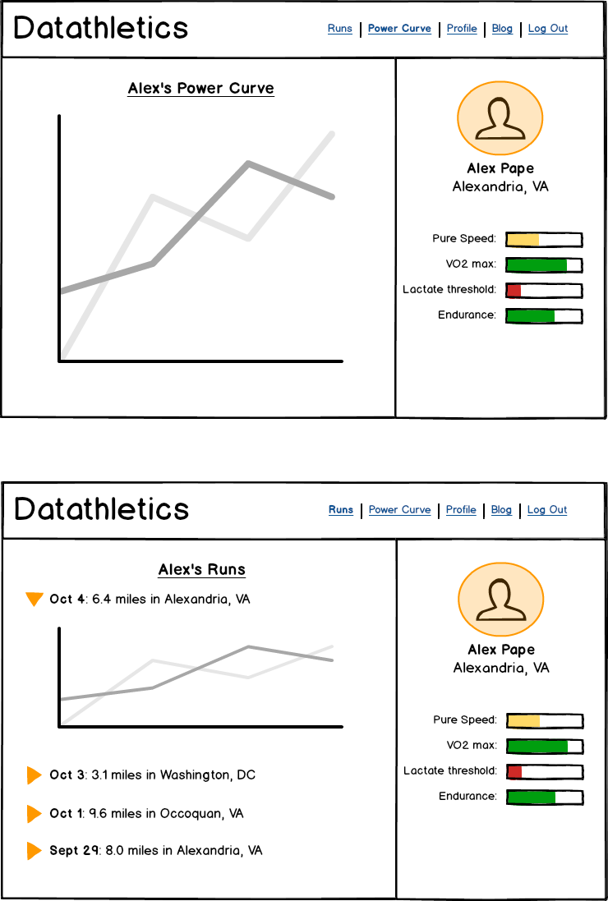

Slide 24
Questions ?

